Slide 1
Vsb engineering college
(AN AUTONOMOUS INSTITUTION)
Department of Electronics And Communication Engineering
Presents
CLEANING ROBOT
-S.NAGADEEPA
-A.NISHA VINCY
-T.PUNITHA

Slide 2
CONTENTS
Definition
Components used
Working
Circuit model
Advantages
conclusion

Slide 3
DEFINITION
The cleaning robot is a device which can be operated by connecting Bluetooth.
It can also be operated automatically, with the help of ultrasonic connected to it.

Slide 4
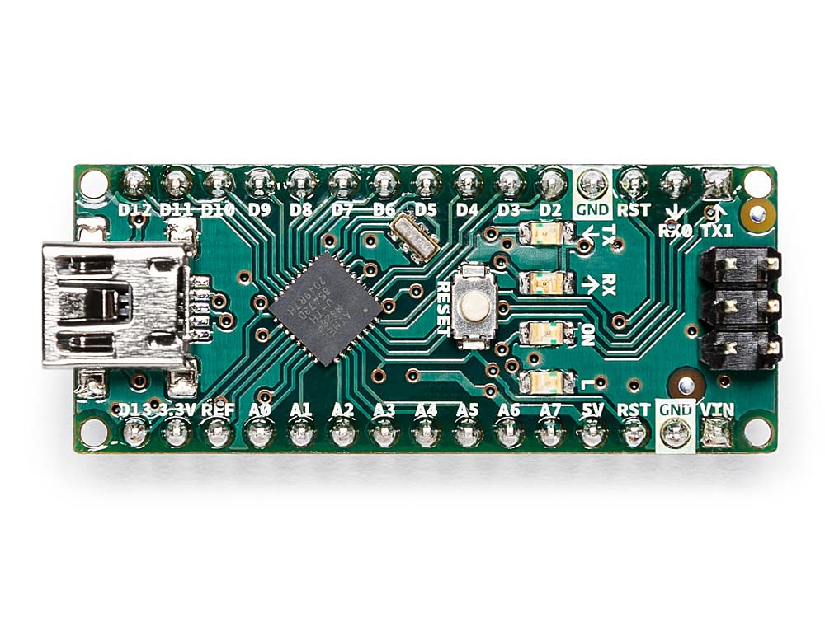
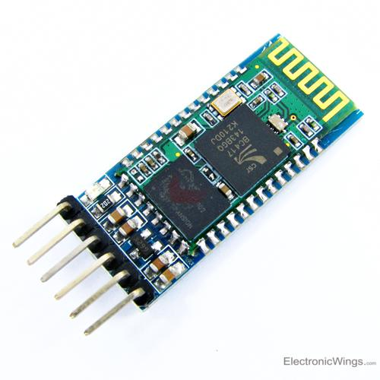
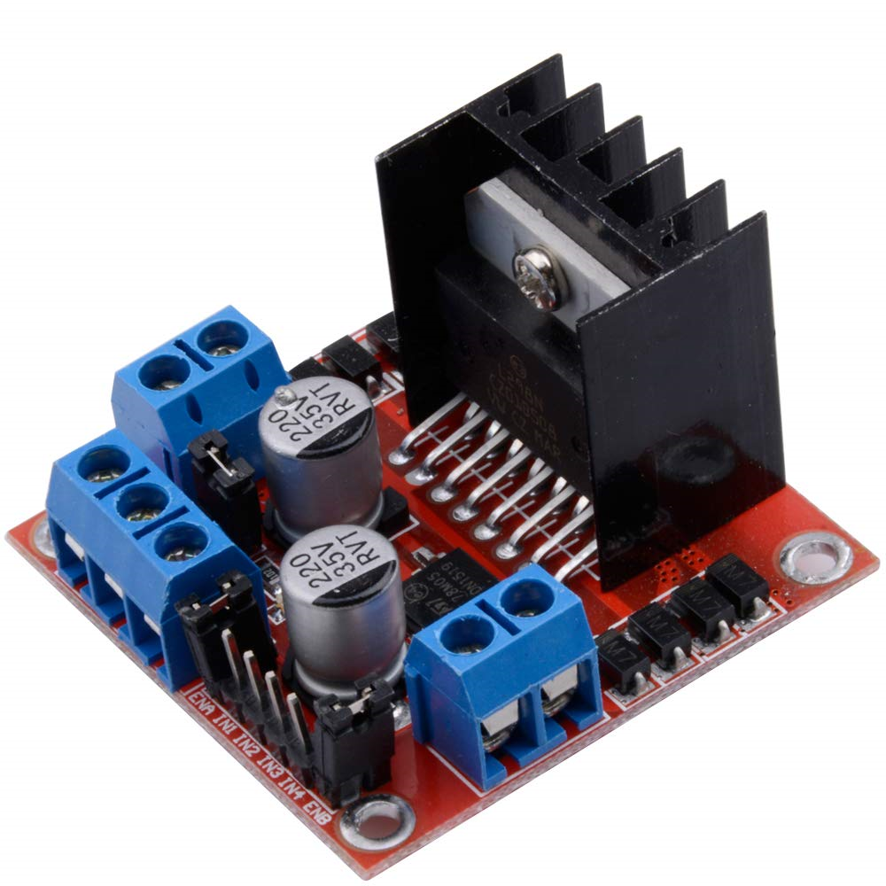
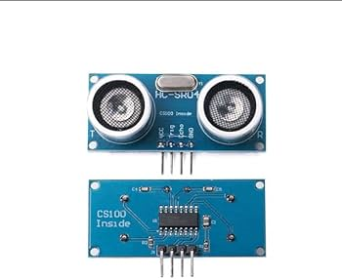
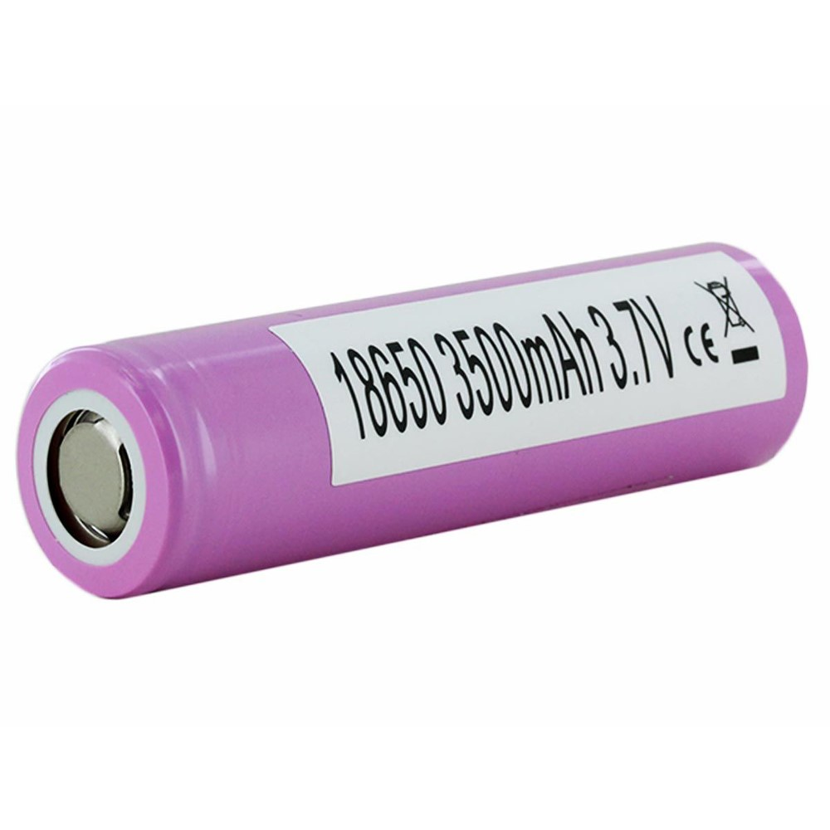
Components used
Arduino nano
Ultrasonic sensors
Motor drive
Lithium ion battery
Bluetooth module

Slide 5
WORKING
When bluetooth module is connected with our device we can operate the robot through the connected device.
The robot can also be used in automated way, as ultrasonic sensors are connected .
To provide water supply, motor is connected along with motor drive.
This robot can move forward, backward and can also rotate in 360 degree.
The battery used in this robot is lithium ion battery, which is rechargeable.

Slide 6
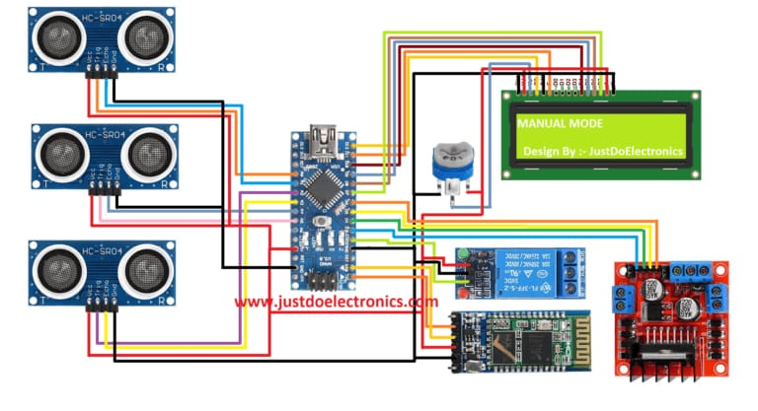
Circuit model

Slide 7
advantages
Time and energy is saved.
The battery is rechargeable.
It can be operated by Bluetooth .
It can also be used as automated robot.

Slide 8
conclusion
After an overall conclusion it was clear that, this cleaning robot can be useful for us and it can save our time too. And have learnt about Arduino, Bluetooth module, and ultrasonic sensors.

Slide 9
Thank you

